Slide 1
CS296 Final Project
By Yuta Inoue and Marco Valentino

Slide 2
Motivation
Make music with an untraditional input
Experience in image processing and sound synthesis
Theremin through software

Slide 3
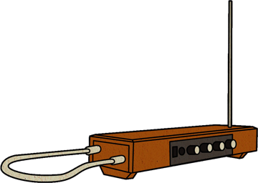
What is a Theremin?
Only musical instrument you can play WITHOUT touching it
Left antenna controls volume
Right antenna controls pitch

Slide 4
First Attempt: Hackathon Prototype
Goal 1: Moving hands up/down simulate a Theremin
Goal 2: Finish within 8 hours
1. OpenCV library for video input
2. Matrix manipulation for image processing
3. PortAudio library for sound synthesis
Issue: Processing a video stream had a BIG lag

Slide 5
Second Attempt: Parallel Programming
Goal 1: Moving hands closer/father for Theremin
Goal 2: Reduce lag for video processing
1. Used skin color recognition to capture hands
2. Used face detection to remove face
3. Calculate size of hands per half screen
Issue: Lag was reduced, but still had a visible effect

Slide 6
Third Attempt: Refine and Condense
Goal 1: Remove unnecessary components
Goal 2: Make it run faster and smoother
1. Removed facial recognition
2. Replaced skin recognition with color recognition + gloves
3. Fixed the audio for smoother output
Issue: We’ll take a look in the future improvements slide.

